Slide 1


Migraine
David W. Dodick, M.D.
Professor
Department of Neurology
Mayo Clinic
Phoenix Arizona

Slide 2



2012
Migraine is the 3rd most prevalent medical disorder on the planet
Migraine accounts for > 30% of the disability burden attributable to all neurological disease worldwide.
Overall, it is the 4th ranking cause among women and the 7th ranking cause of all disease-associated disability worldwide.
Lancet 2012; 380: 2197–223

Slide 3
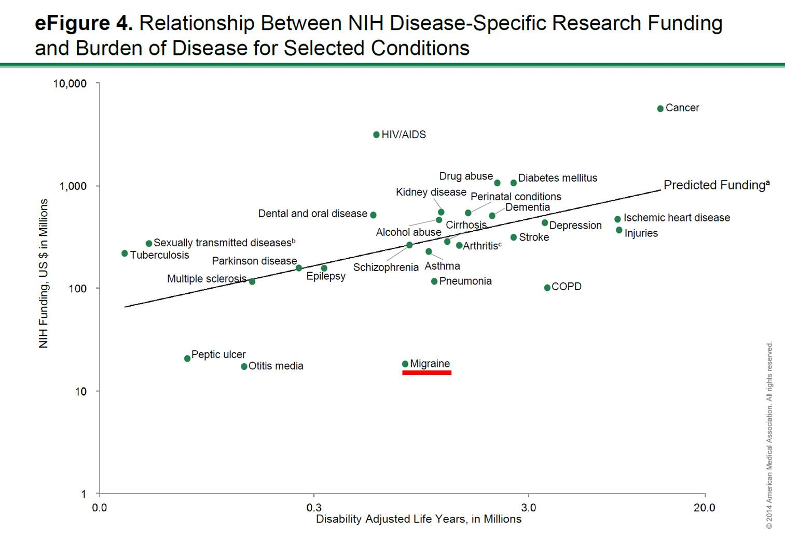

Slide 4
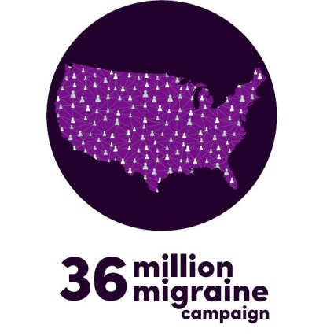
Lack of Progress
Triptans: 1 single class of symptomatic medication developed by industry
No treatments designed and approved for migraine prevention

Slide 5
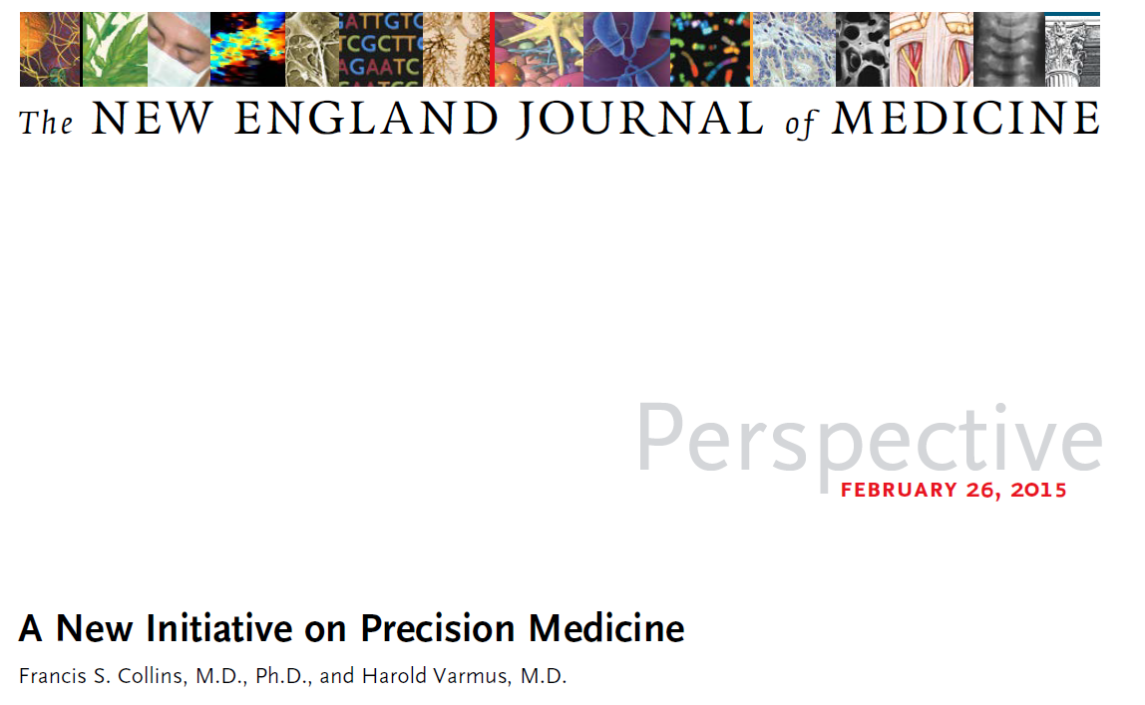
the prospect of applying this concept broadly has been dramatically improved by the recent development of large-scale biologic databases
Notes:
The concept of precision medicine
— prevention and treatment
strategies that take individual
variability into account

Slide 6

Migraine Patient Registry
And Biorepository
Large-scale, longitudinal, publicly accessible repository
Migraine Data
Biomarker discovery
Clinical
Biologic
Neuroimaging
Genetic discovery
Precision Medicine
New drug discovery

Slide 7
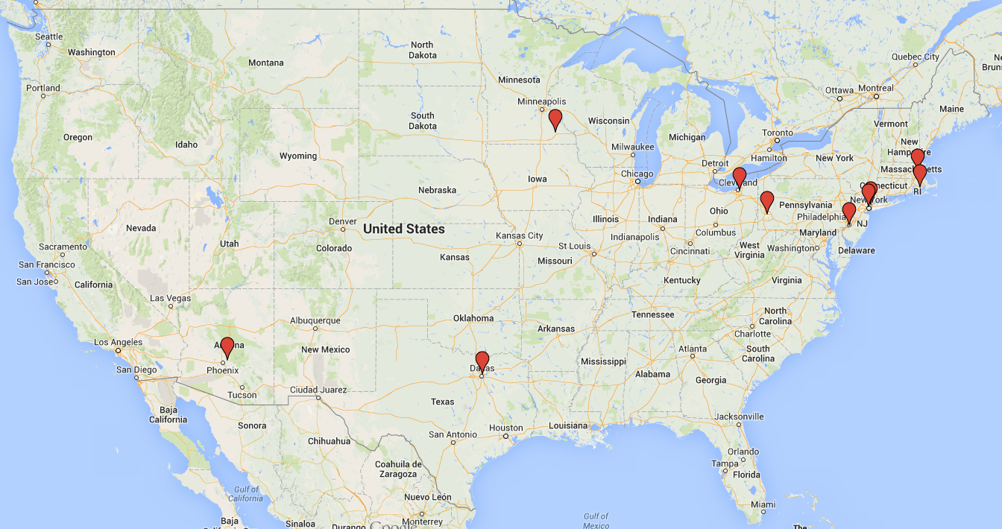
US Academic Headache Consortium - Then
  Baylor Neuroscience Center
  Brigham & Women’s Hospital
  Cleveland Clinic
  Dartmouth Medical Center
  Mayo Clinic MN
  Mayo Clinic AZ
  Montefiore Medical Center/Albert Einstein
  Roosevelt Hospital Center
  Thomas Jefferson University
  University of Pittsburgh

Slide 8
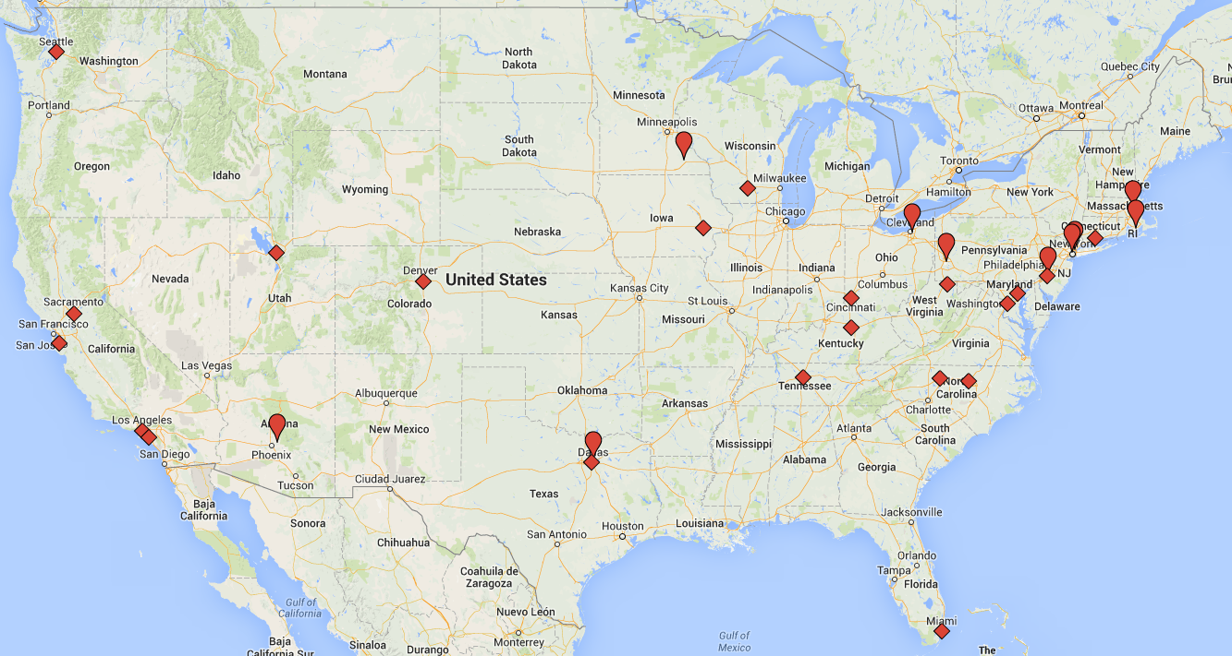
Academic Headache Consortium - Now
  UC Davis
  Stanford University
  University of Kentucky
  Yale University
  University of Southern California
  University of Miami
  University of Utah
  University of Texas Southwestern
  University of Cincinnati
  Johns Hopkins University
  UC Irvine
  University of Iowa
  University of Washington
  Children’s Hospital University of Pennsylvania
  West Virginia University
  Vanderbilt
  University of Colorado
  Georgetown
  Duke University
  Wisconsin Medical Center
  Wake Forest University

Slide 9
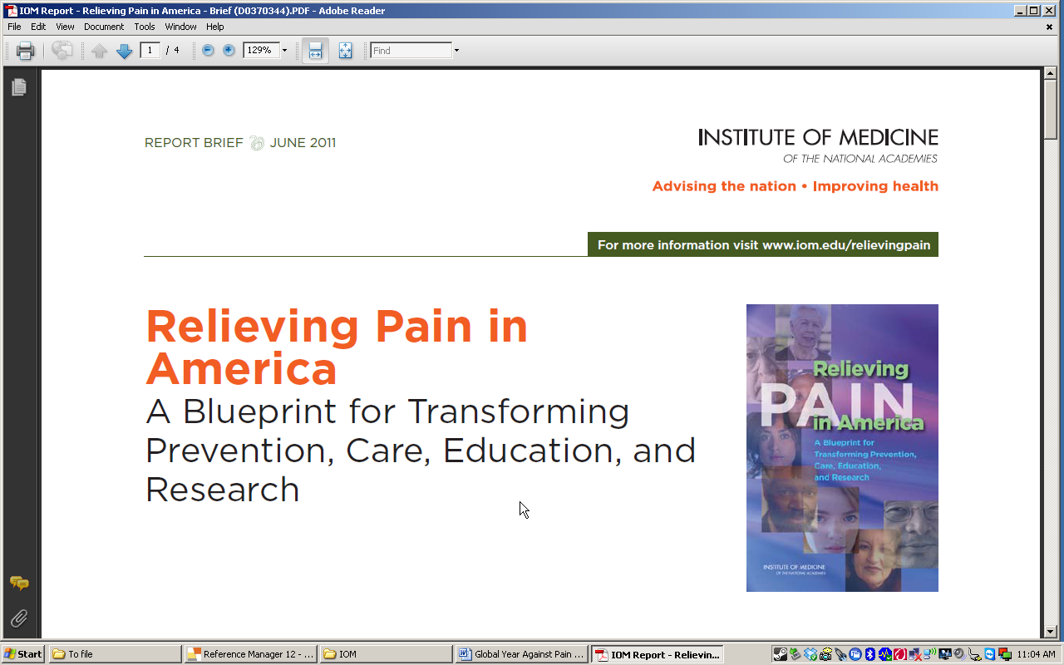
Chronic pain affects 100M Americans
560-635 billion annually
Call for a cultural transformation in the way that pain is understood, assessed and treated

Slide 10
October 2012: Assistant Secretary for Health, Department of Health and Human Services tasked
IPRCC and NIH to address IOM Recommendation 2-2.
  “develop a comprehensive, population health-level strategy for pain prevention, treatment, management, education, reimbursement, and research that includes specific goals, actions, time frames, and resources.”
Notes:
The IOM recommended the Secretary HHS to address recommendation 2.2.
With the ACA implementation underway, Assistant Secretary for Health, then Dr. Koh, turned to the IPRCC and the NIH to take on the challenge.
The IPRCC accepted with some hesitation, given that it was an advisory group for pain research, and recommendation 2.2 was much broader than research.

Slide 11
The National Pain Strategy
Public Education & Communication
Public Health Disparities
Public Health Care & Prevention
Public Health: Service Delivery & Reimbursement
Population Research
Professional Education & Training
Oversight Panel
Refine and employ standardized electronic health care data methods to track prevalence, treatment, outcomes and costs of care.
  Develop data standards/definitions for EHRs, population-level surveys, and relevant clinical research to track pain prevalence and treatment and outcomes in vulnerable populations.

Slide 12



Achieving the goals of the National Pain Strategy would lead to the recognition of chronic pain as a complex disease and a threat to public health, and a national decrease in prevalence across the continuum of pain, thereby reducing the burden of pain for individuals, families, and society as a whole.
.

